Slide 1


Vahid Sahraei
August 2025
https://github.com/vahidsahraei/Applied-Data-Science-Capstone

Slide 2

Outline
Executive Summary
Introduction
Methodology
Results
Conclusion
Appendix

Slide 3
Executive Summary
In this project, data from the SpaceX API and Wikipedia was collected and processed to create a dataset with a classification label for successful landings. The dataset was prepared using SQL, visualizations, feature selection, one-hot encoding, and standardization. Model optimization was performed with GridSearchCV, and results were presented through dashboards and accuracy metrics.
Four machine learning models, Logistic Regression, SVM, Decision Tree, and KNN were developed, each achieving approximately 83.3% accuracy.
All models showed a tendency to over-predict successful landings.
Additional data is needed to enhance model robustness, selection, and predictive accuracy.

Slide 4
Introduction
Project Background and Context:
This capstone project focuses on predicting the successful landing of the Falcon 9 first stage. SpaceX offers launches at a significantly lower cost than other providers, primarily due to the reusability of its first-stage rockets. By accurately predicting landing success, this project aims to estimate launch costs and provide actionable insights for companies competing with SpaceX.
Problem: As data scientists at SpaceY, we are tasked with developing a machine learning model to predict the successful recovery of the Falcon 9 first stage

Slide 5

Section 1

Slide 6
Methodology
Data collection methodology:
Collected data from SpaceX public API and WikipediaPerformed data wrangling and classification of landings (successful vs. unsuccessful)
Performed data wrangling and classification of landings (successful vs. unsuccessful)
Data Analysis & Visualization
Conducted exploratory data analysis (EDA) using SQL and visualizations
Created interactive visual analytics with Folium and Plotly Dash
Predictive Modeling
Built classification models to predict landing success
Optimized model parameters using GridSearchCV

Slide 7
Data Collection
Step 1
SpaceX API Request
Initiated API request to fetch launch data
Stored data locally
Step 2
Web Scraping (Wikipedia)
Extracted launch table
Parsed with BeautifulSoup
Converted to DataFrame
Step 3
Data Integration
Combined SpaceX API data with Wikipedia data
Merged into a final integrated dataset

Slide 8
Data Collection – SpaceX API
GitHub URL:
https://github.com/vahidsahraei/Applied-Data-Science-Capstone/blob/main/(1)%20jupyter-labs-spacex-data-collection-api.ipynb
Initiate API Request (requests.get)
Fetch Launch Data (launch dates, sites, payloads, outcomes, etc.)
Parse JSON Response (response.json())
Extract Relevant Fields (date, site, payload, rocket, outcome)
Store Data in DataFrame (pandas.DataFrame)
Save Data Locally (data.csv or database)

Slide 9
Data Collection - Scraping
Request Web Page (requests.get)
Parse HTML Content (BeautifulSoup)
Extract Launch Records (HTML table)
Convert HTML Table to DataFrame (pandas.DataFrame)
Clean and Format Data (drop nulls, standardize columns)
GitHub URL: https://github.com/vahidsahraei/Applied-Data-Science-Capstone/blob/main/(2)%20jupyter-labs-webscraping.ipynb

Slide 10
Data Wrangling
Step 1: Data Cleaning
Identify and handle missing values (impute or remove).
Drop rows/columns with excessive missing data.
Step 2: Data Transformation
Convert data types (e.g., dates, numeric).
Standardize text (lowercase, remove whitespace).
Create new features (e.g., extract year from date).
Normalize/scale numerical values.
Step 3: Data Integration
Merge datasets from multiple sources (API, web scraping).
Ensure consistent column names and data formats.
Step 4: Data Validation
Remove duplicate records.
Verify accuracy and consistency of entries.
GitHub URL: https://github.com/vahidsahraei/Applied-Data-Science-Capstone/blob/main/(3)%20labs-jupyter-spacex-Data%20wrangling.ipynb

Slide 11
EDA with Data Visualization
Key variables: Flight Number, Payload Mass, Launch Site, Orbit, Class, Year
Visualizations: Scatter, Line, and Bar Charts
Relationships examined:
Flight Number vs. Payload & Launch Site
Payload vs. Launch Site & Orbit
Orbit vs. Success Rate
Yearly Success Trend
Goal: Identify patterns to support machine learning model training
GitHub URL: https://github.com/vahidsahraei/Applied-Data-Science-Capstone/blob/main/(5)%20EDA%20Data%20Visualisation.ipynb

Slide 12
EDA with SQL
Loaded dataset into IBM DB2 database.Visualizations: Scatter, Line, and Bar Charts
Used SQL via Python integration for querying.
Explored dataset to understand:
Launch site names
Mission outcomes
Payload sizes and customer info
Booster versions
Landing outcomes
GitHub URL: https://github.com/vahidsahraei/Applied-Data-Science-Capstone/blob/main/(4)%20jupyter-labs-eda-sql-coursera_sqllite.ipynb

Slide 13
Build an Interactive Map with Folium
Interactive Map with Folium show:
Launch Sites
Successful vs. Unsuccessful Landings
Proximity to key locations: Railway, Highway, Coast, City
Purpose:
Understand launch site placement
Visualize landing success relative to location
GitHub URL: https://github.com/vahidsahraei/Applied-Data-Science-Capstone/blob/main/(6)%20Visualisation_maps_launch_site_location.ipynb

Slide 14
Build a Dashboard with Plotly Dash
Visuals: Pie Chart & Scatter Plot
Pie Chart:
Shows overall distribution of successful landings
Can display individual launch site success rates
Scatter Plot:
Inputs: All sites or selected site, Payload Mass (0–10,000 kg)
Shows how success varies by launch site, payload, and booster version
Purpose: Interactively explore relationships and trends in landing success
GitHub URL: https://github.com/vahidsahraei/Applied-Data-Science-Capstone/blob/main/spacex-dash-app.py

Slide 15
Predictive Analysis (Classification)
Data Preprocessing
Model Selection
Hyperparameter Tuning
Model Evaluation
Improvement Iterations
Best Performing Model
https://github.com/vahidsahraei/Applied-Data-Science-Capstone/blob/main/SpaceX_Machine%20Learning%20Prediction_Part_5.ipynb

Slide 16
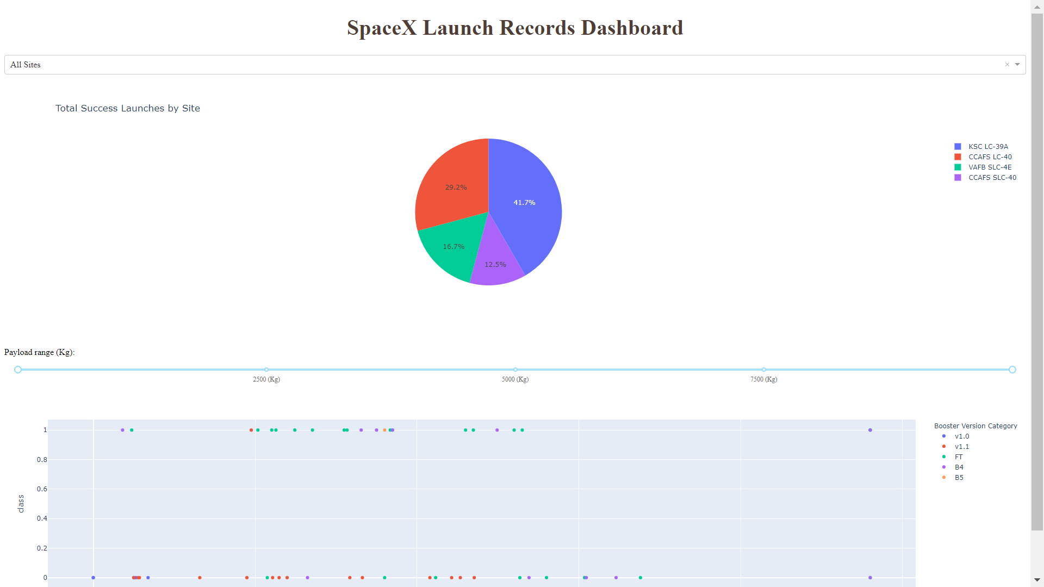
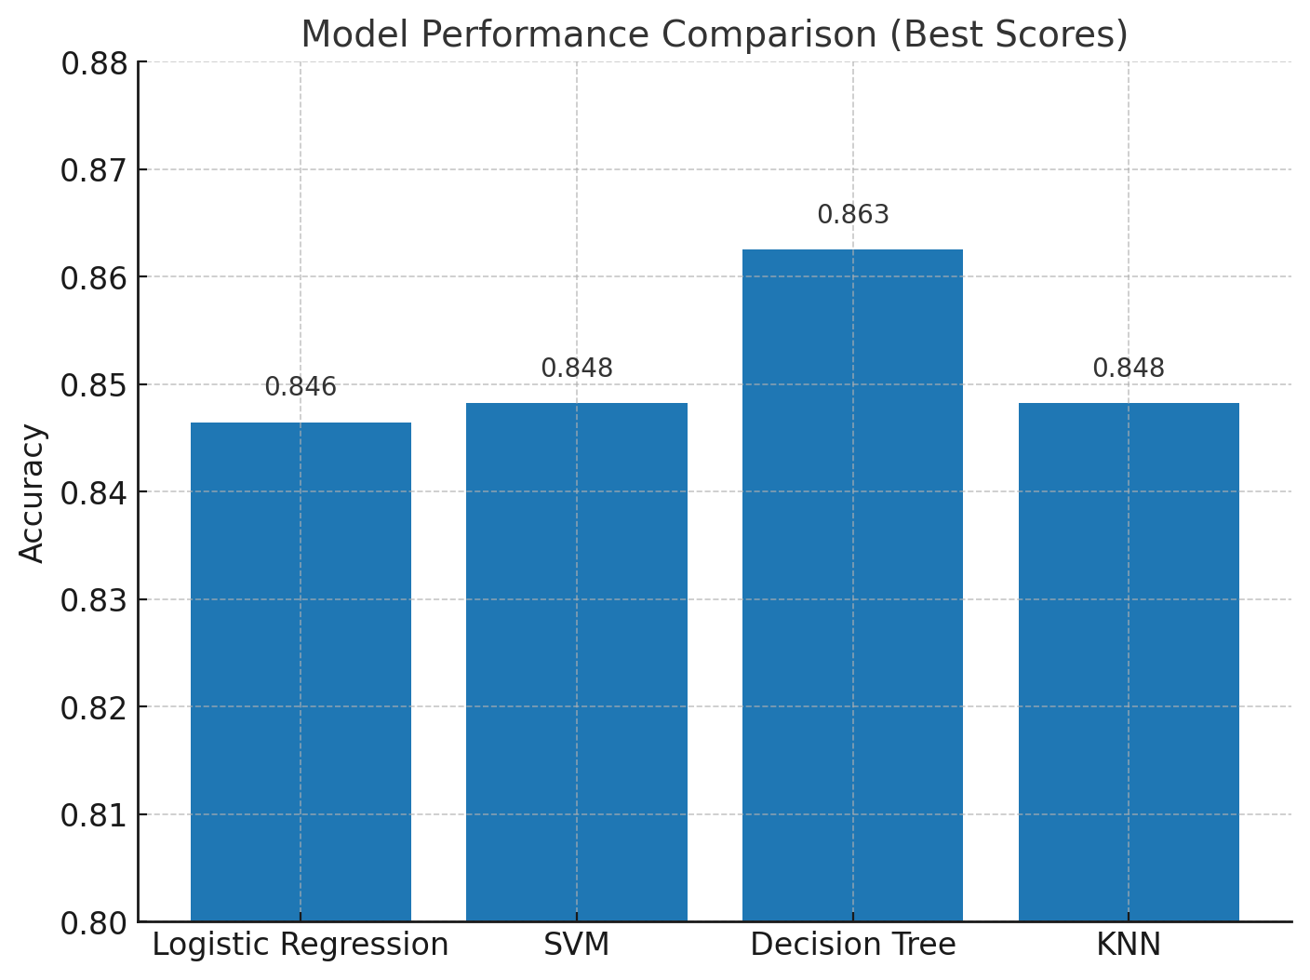
Results
Plotly dashboard
Predictive analysis results

Slide 17

Section 2

Slide 18
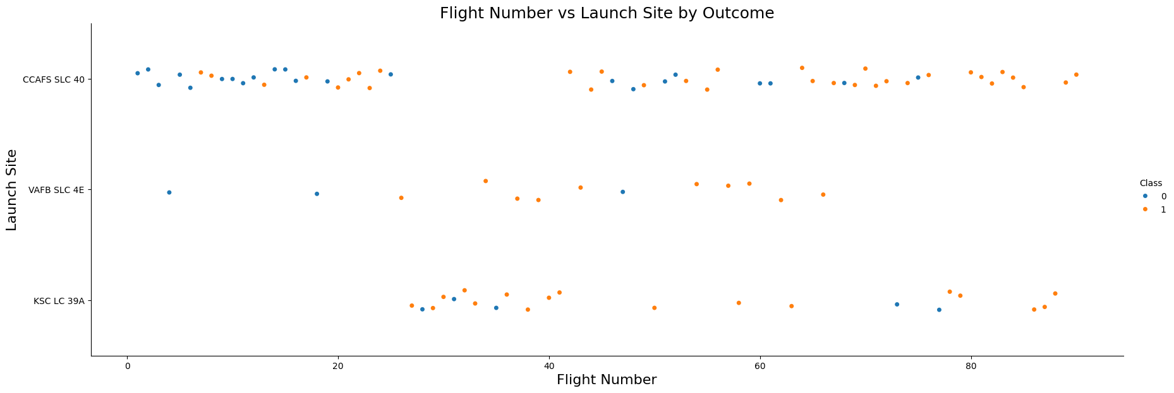
Flight Number vs. Launch Site
Success on the Rise: Success rate climbs steadily with flight number — major breakthrough after Flight 20.
CCAFS Leads the Way: it dominates with the highest number of launches.
Mixed Results at Key Sites: Both CCAFS SLC-40 and KSC LC-39A show successes and failures — location alone isn’t the driver.

Slide 19
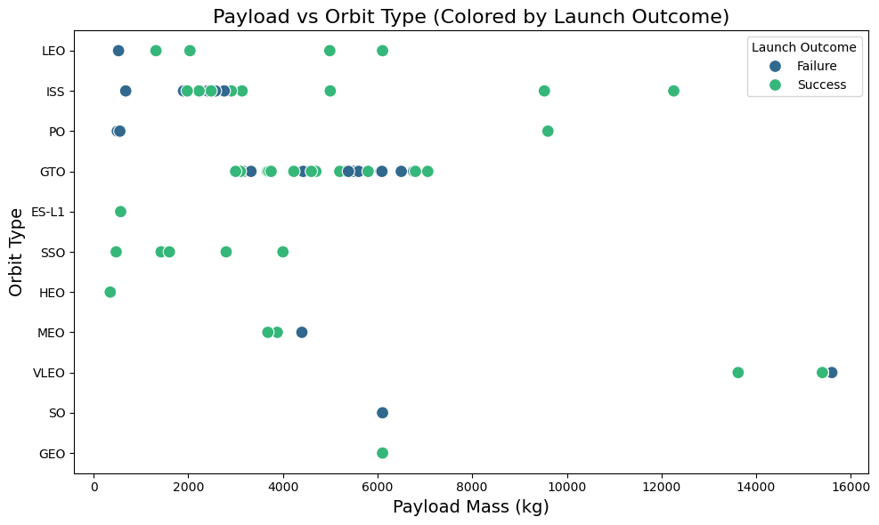
Payload vs. Launch Site
Payload Distribution: CCAFS SLC-40 mainly launches <10,000 kg, while VAFB SLC-4E and KSC LC-39A support a wider range
High-Capacity Launches: KSC LC-39A stands out for handling heavier payloads, with several missions exceeding 15,000 kg, highlighting its role in high-capacity.

Slide 20
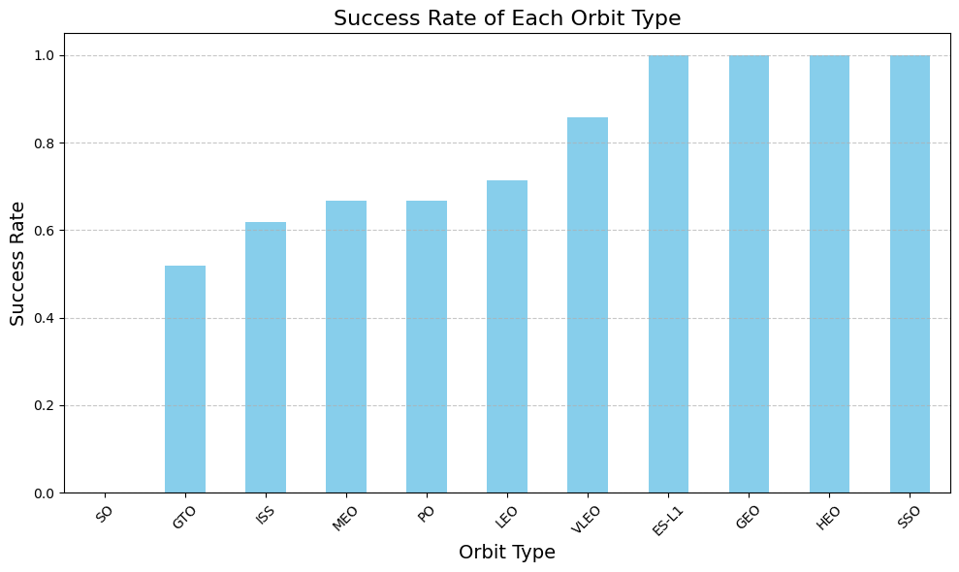
Success Rate vs. Orbit Type
100% Success: ES-L1 (1), GEO (1), HEO (1), SSO (5)
Strong Performance: VLEO (14) – good success & attempts
Low Success: SO (1) – 0% success
Mixed Results: GTO (27) – ~50% success, largest sample

Slide 21
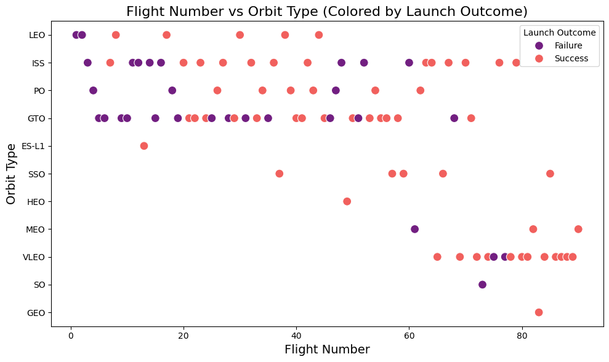
Flight Number vs. Orbit Type
Success increased Over Time: Falcon 9 launch success rises with higher flight numbers, showing the impact of experience and iterative improvements. This trend is clear in LEO, where more flights correlate with higher success.
Orbit-Specific Performance:
For GTO, success shows no clear link to flight numbers. Early GTO and ISS missions had mixed results, but recent ones demonstrate improved outcomes, highlighting advances in planning and execution.
Stronger results in lower and Sun-synchronous orbits.

Slide 22
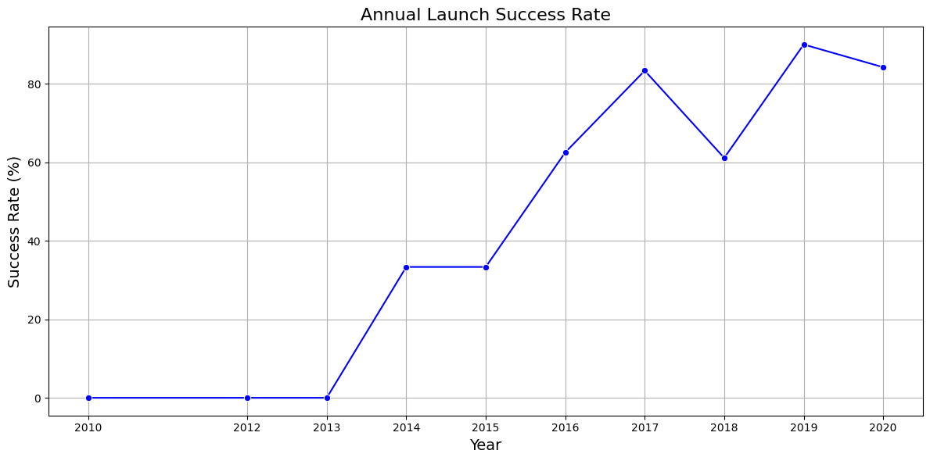
Launch Success Yearly Trend
Steady Improvement: Since 2013, launch success rates climbed, topping 80% by 2020.
Resilient Growth: Aside from a 2018 dip, Falcon 9 has become increasingly reliable.

Slide 23
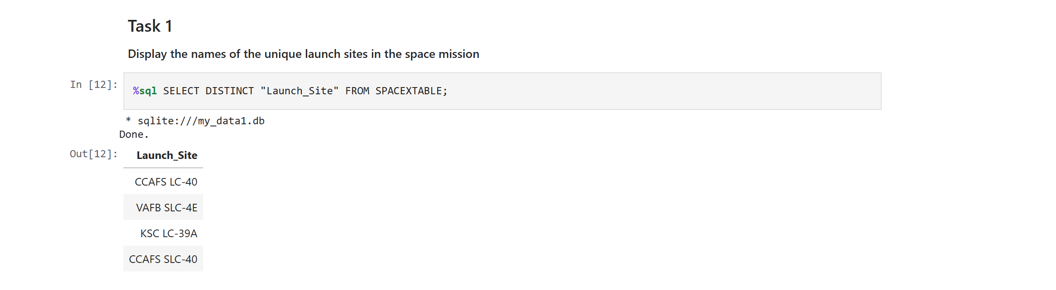
All Launch Site Names
This query returns a list of unique launch sites stored in the SPACEXTABLE.
The SELECT statement retrieves data from a table.The keyword DISTINCT ensures that only unique values are returned, removing duplicates.

Slide 24
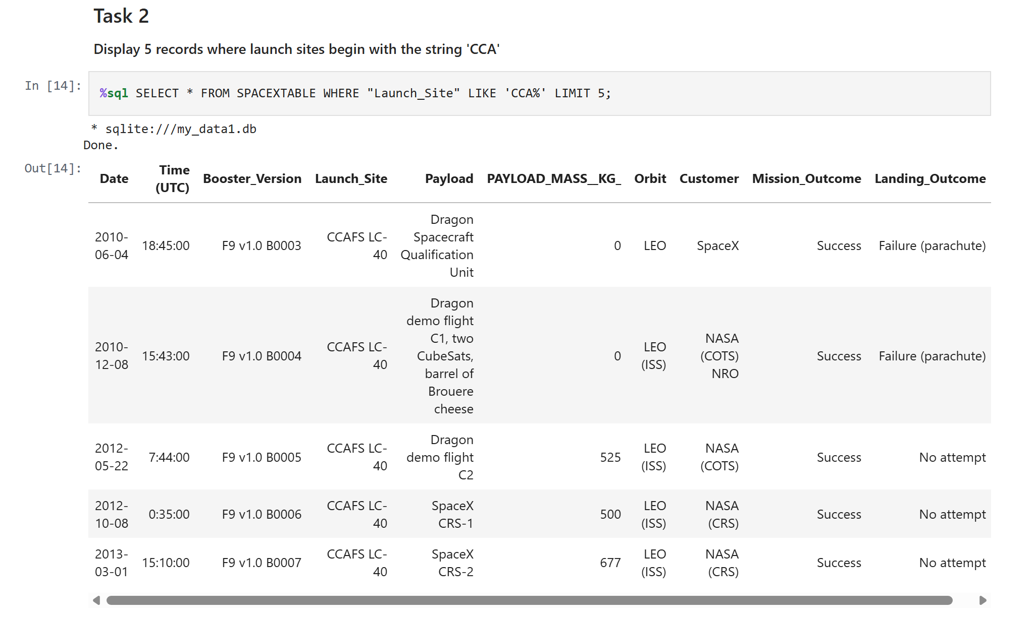
Launch Site Names Begin with 'CCA'
This sql query retrieves the first five records from the database where the Launch Site name starts with ‘CCA’.”

Slide 25
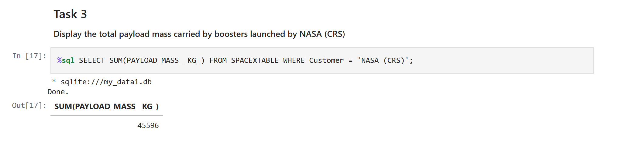
Total Payload Mass
This query sums the total payload mass in where NASA was the customer.

Slide 26
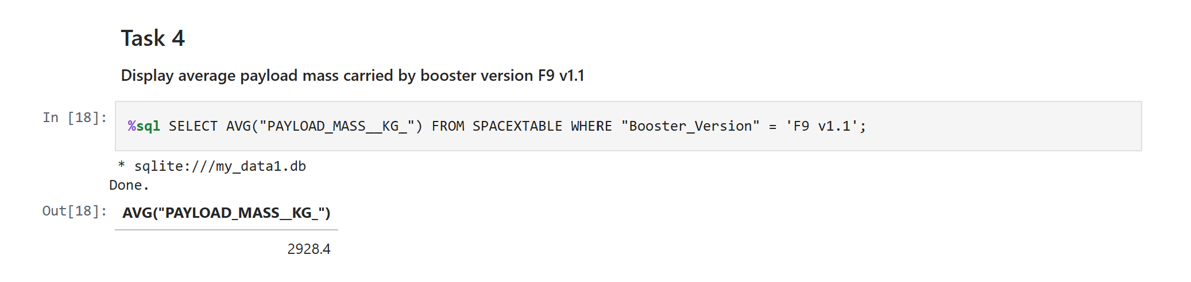
Average Payload Mass by F9 v1.1

Slide 27
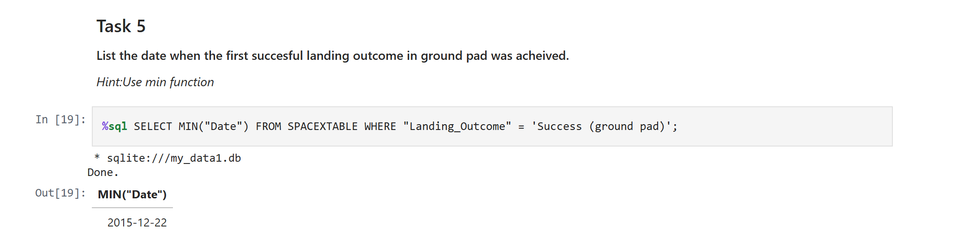
First Successful Ground Landing Date

Slide 28
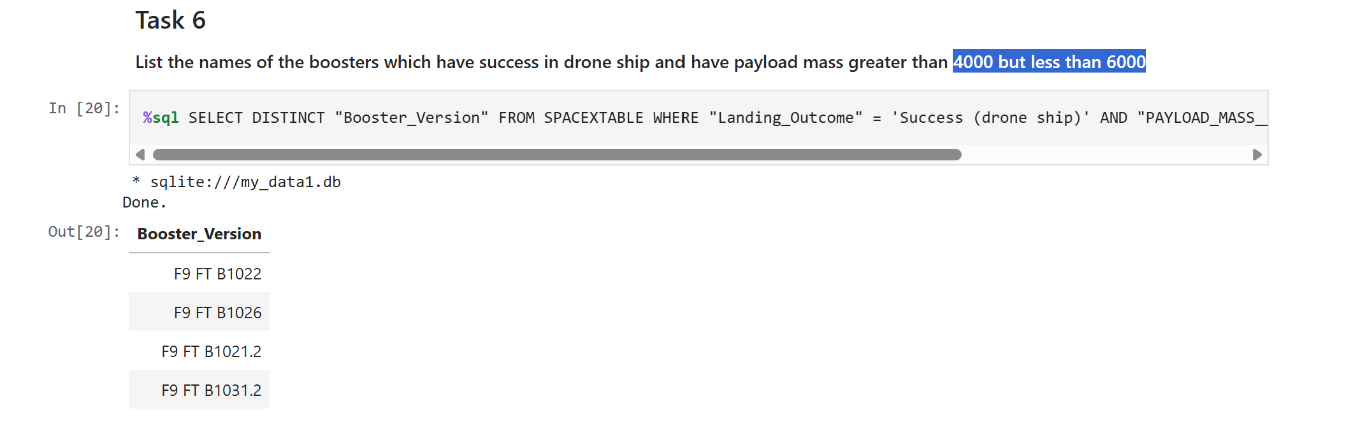
Successful Drone Ship Landing with Payload between 4000 and 6000

Slide 29
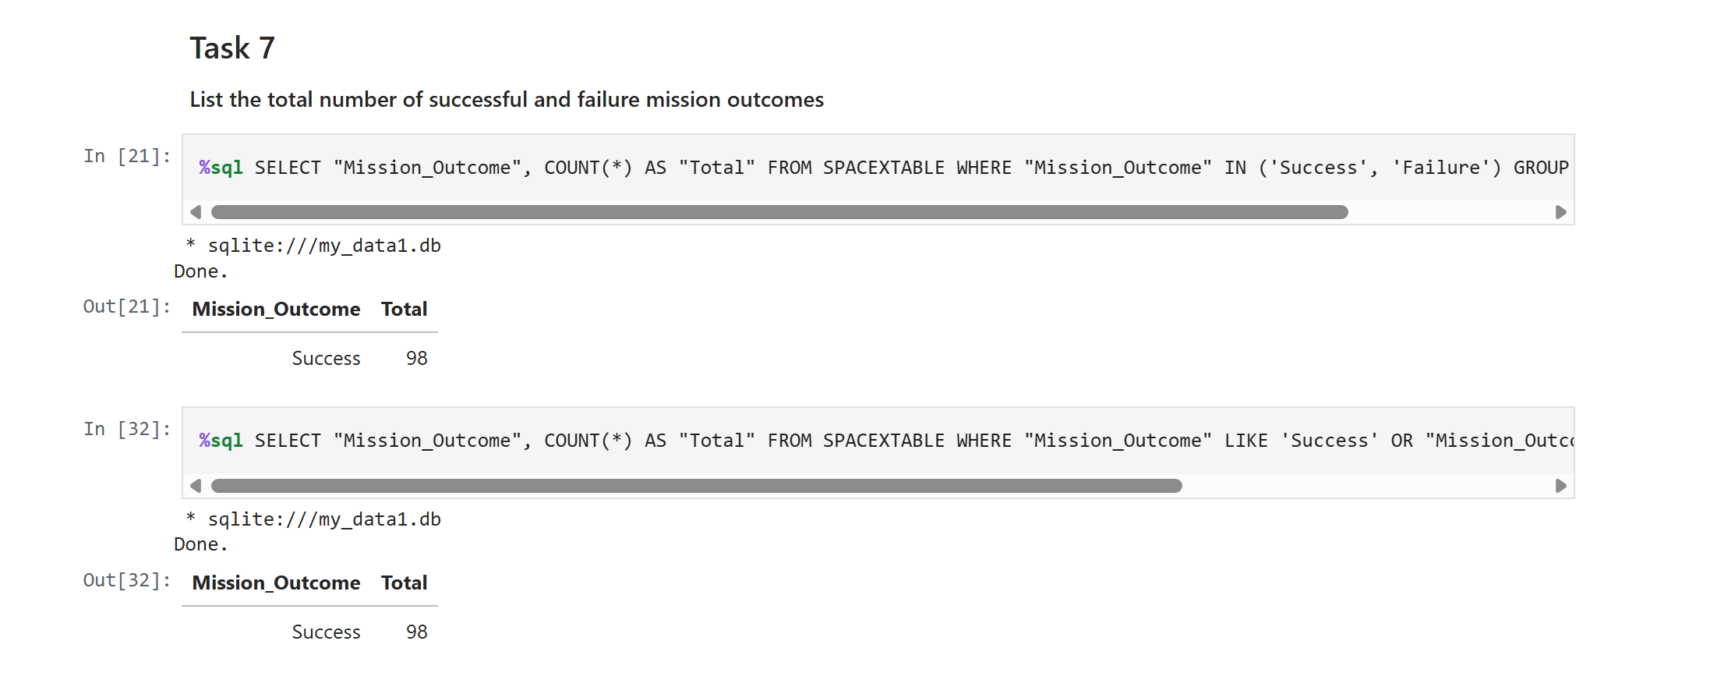
Total Number of Successful and Failure Mission Outcomes

Slide 30
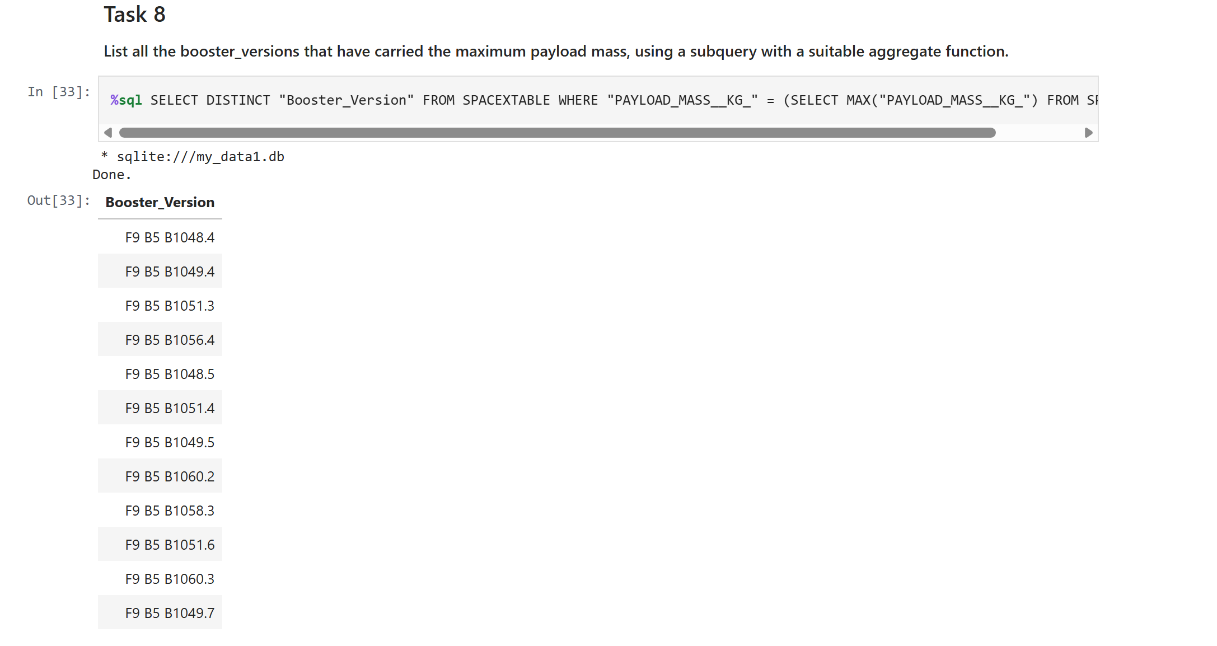
Boosters Carried Maximum Payload

Slide 31
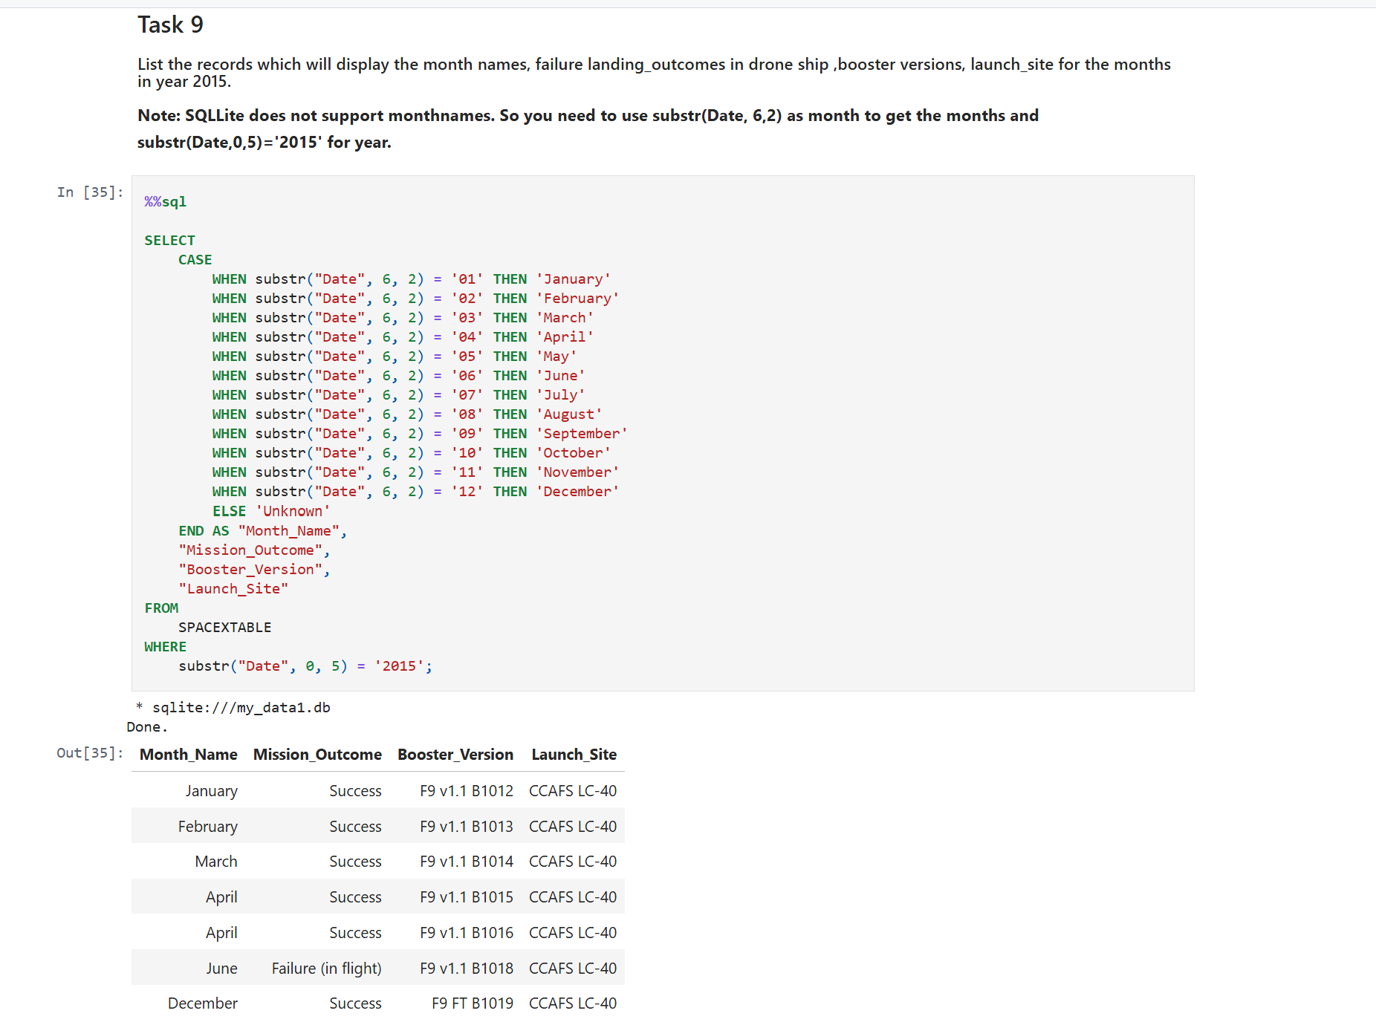
2015 Launch Records

Slide 32
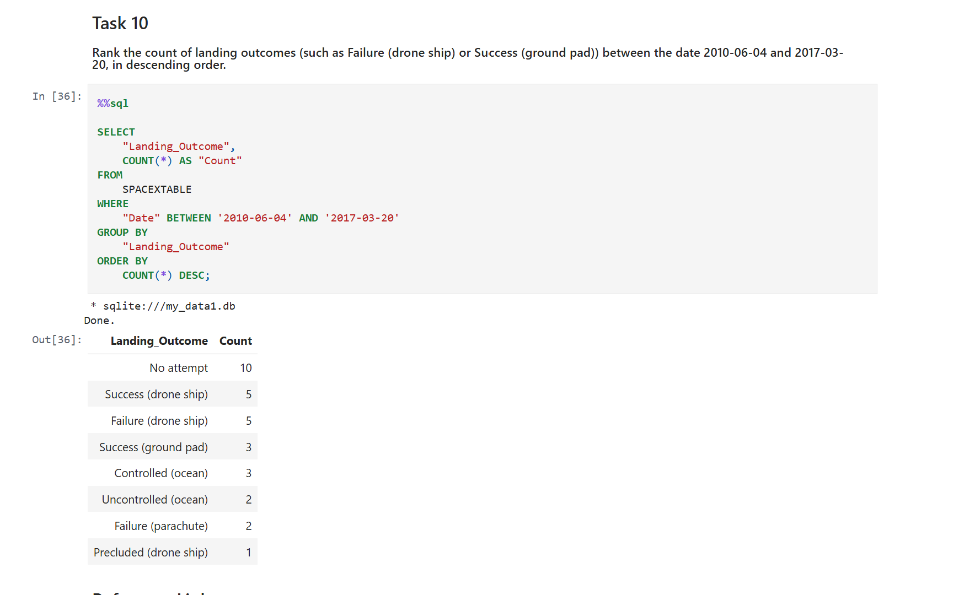
Rank Landing Outcomes Between 2010-06-04 and 2017-03-20

Slide 33

Section 3

Slide 34
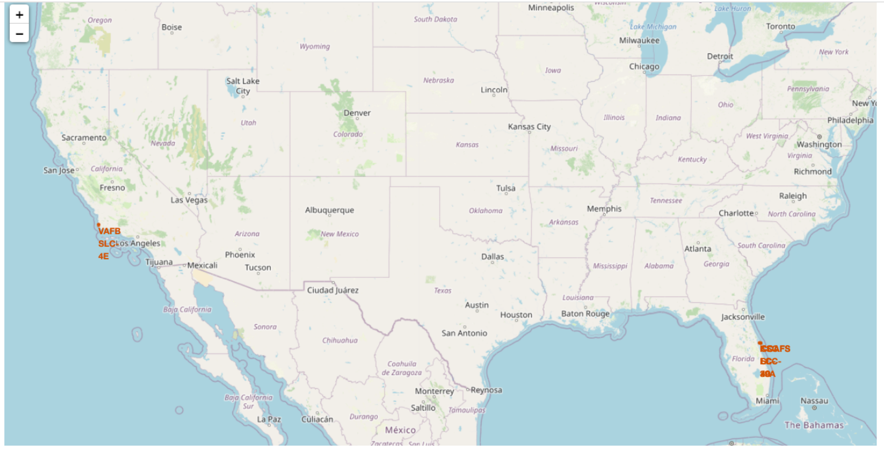
all launch sites on the map
The map shows all launch sites on US map.

Slide 35
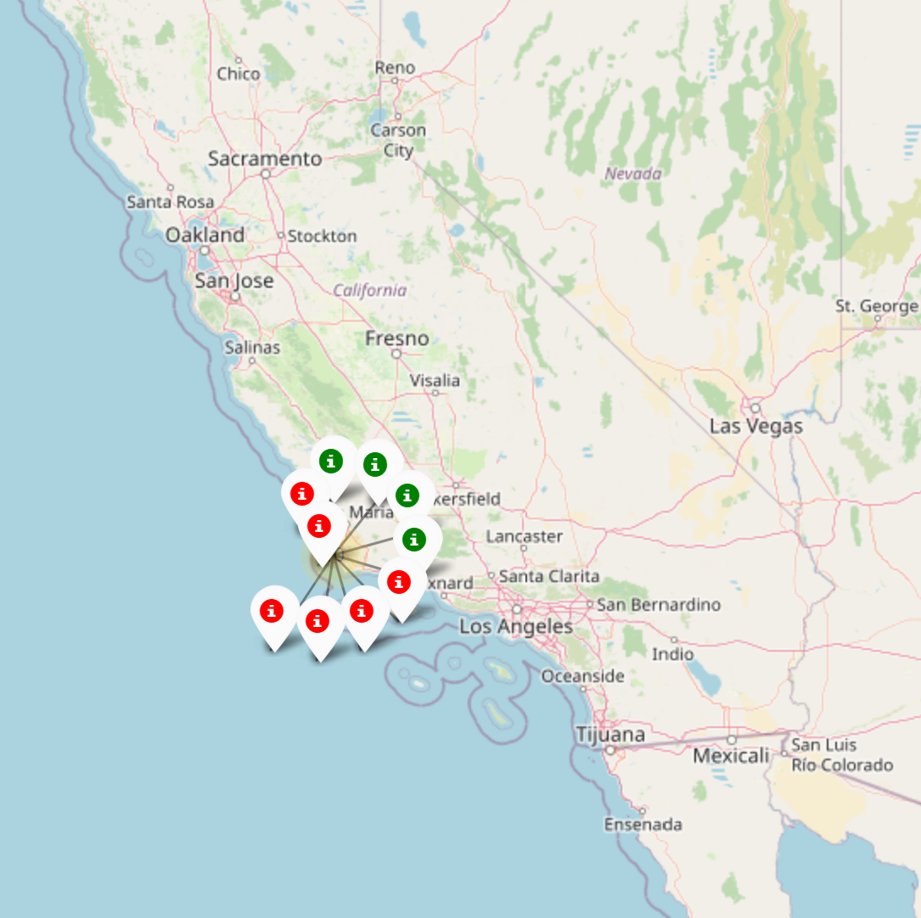
Visualizing Successful and Failed Landings
On the Folium map, clusters can be clicked to reveal individual landings: green icons represent successful landings, and red icons indicate failures. For example, at VAFB SLC-4E, there are 4 successful landings and 6 failed landings

Slide 36
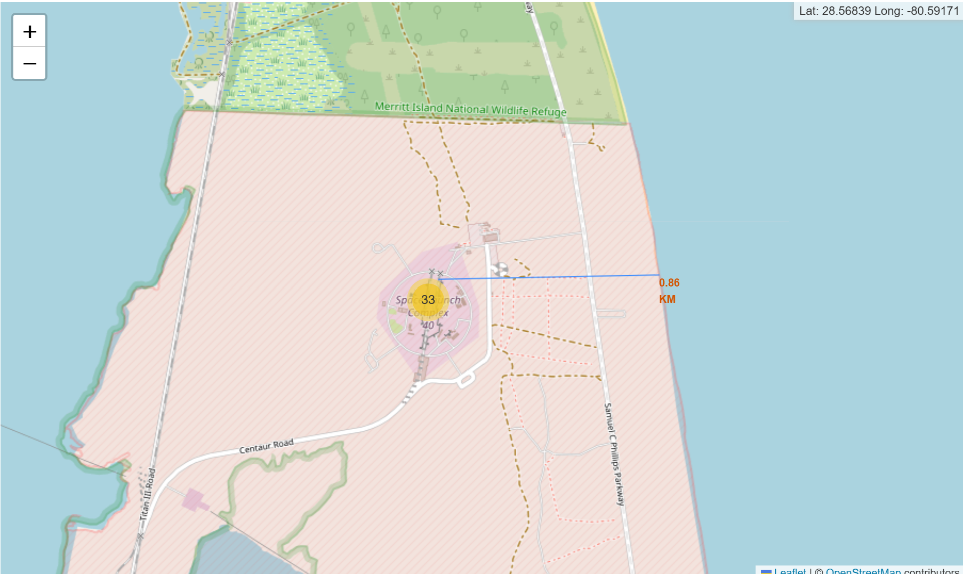
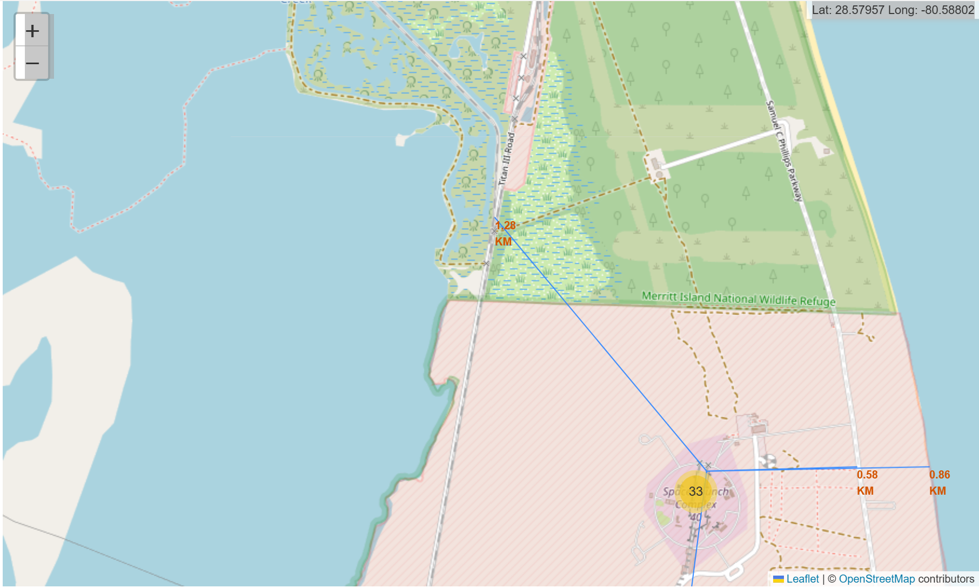
Launch Site Proximity to Infrastructure and Coastline
KSC LC-39A: Key Spatial Features
Railways Nearby: Supports transport of heavy supplies.
Highways Accessible: Facilitates personnel and logistics movement.
Coastal Proximity: Launches occur over water, reducing risk from debris in case of failure.
Far from Cities: Minimizes hazards to populated areas.
Key Insight: Launch sites are strategically positioned to optimize safety, operational efficiency, and logistics, with transport links and coastal access as essential factors in risk mitigatio

Slide 37

Section 4

Slide 38
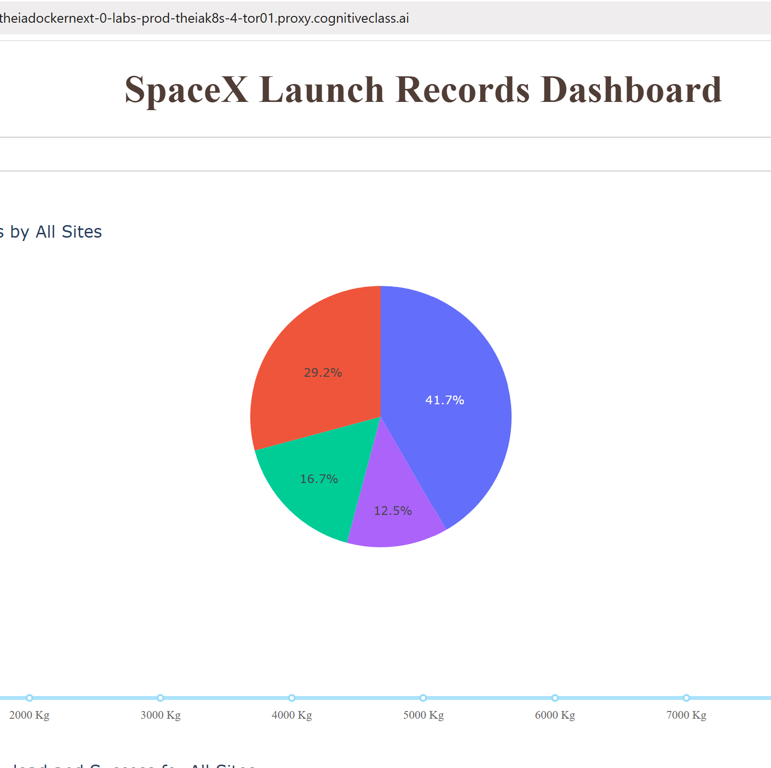
Launch Success Distribution Across Sites
KSC LC-39A leads with 41.7% of all successful launches, highlighting its reliability as SpaceX’s most successful site.
CCAFS LC-40 accounts for 29.2%, making it the second most successful site.
VAFB SLC-4E contributes 16.7% to the total successes.
CCAFS SLC-40 has the smallest share, with 12.5% of successful launches.

Slide 39
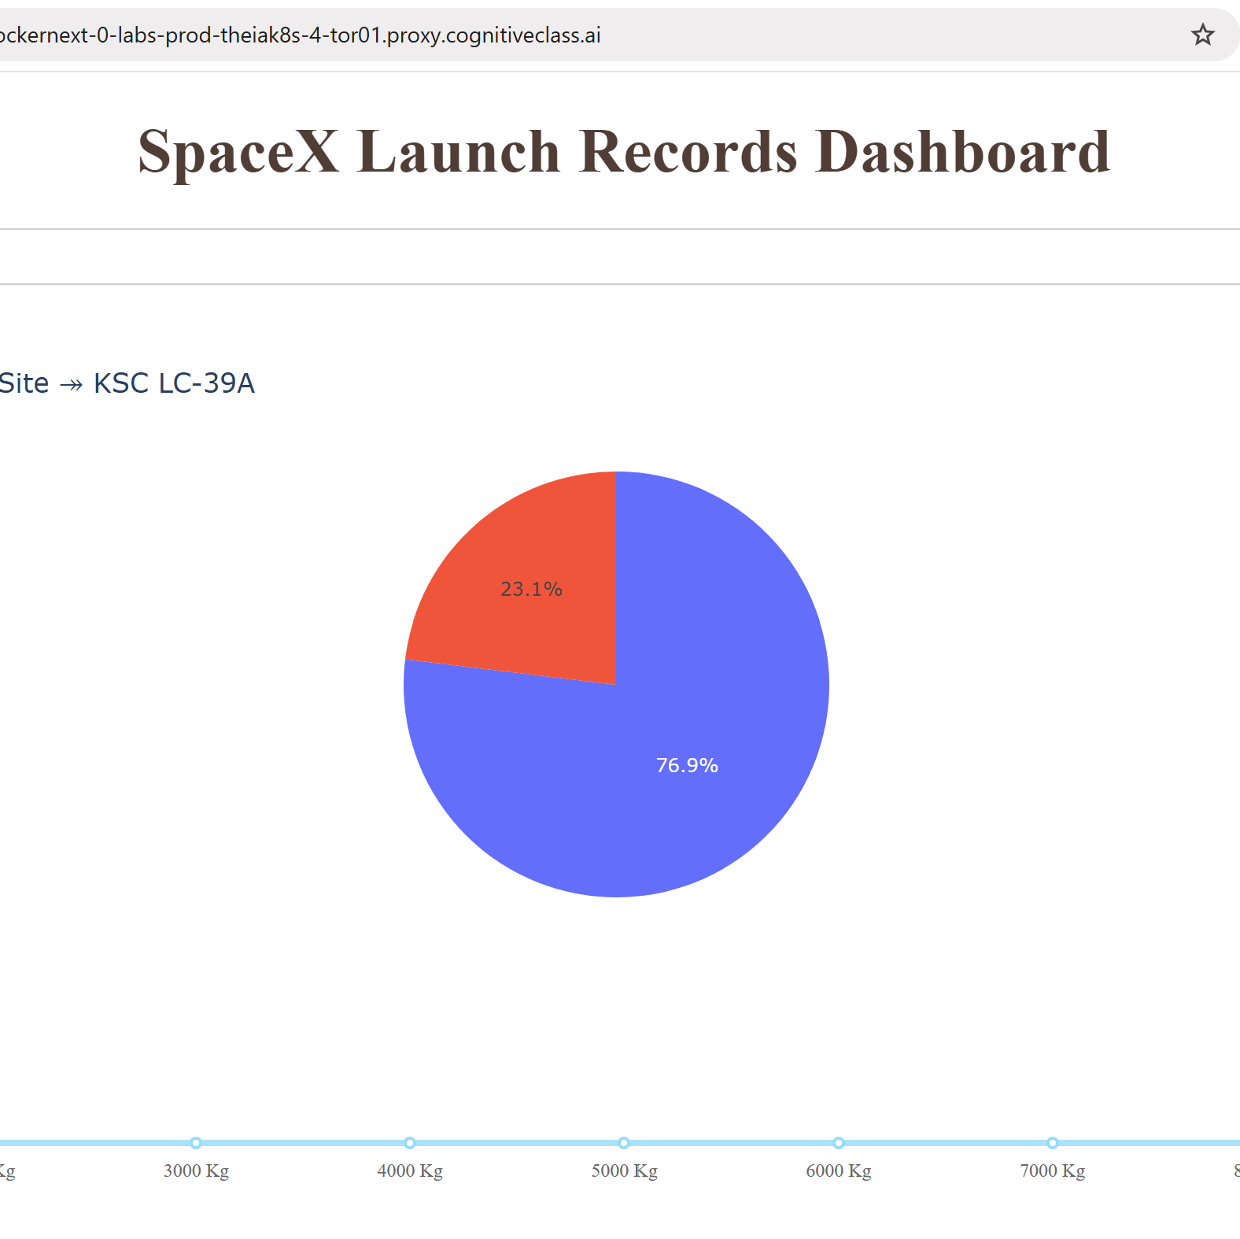
Launch Site with the Highest Success Ratio
The pie chart illustrates the launch outcomes at KSC LC-39A, the site with the highest number of successful launches.
Class 1 (Successful Launches): 76.9% – represented by the dominant blue segment, highlighting the site’s high reliability and effectiveness.
Class 0 (Unsuccessful Launches): 23.1% – shown as the smaller red segment, indicating that while failures exist, they are relatively limited.

Slide 40
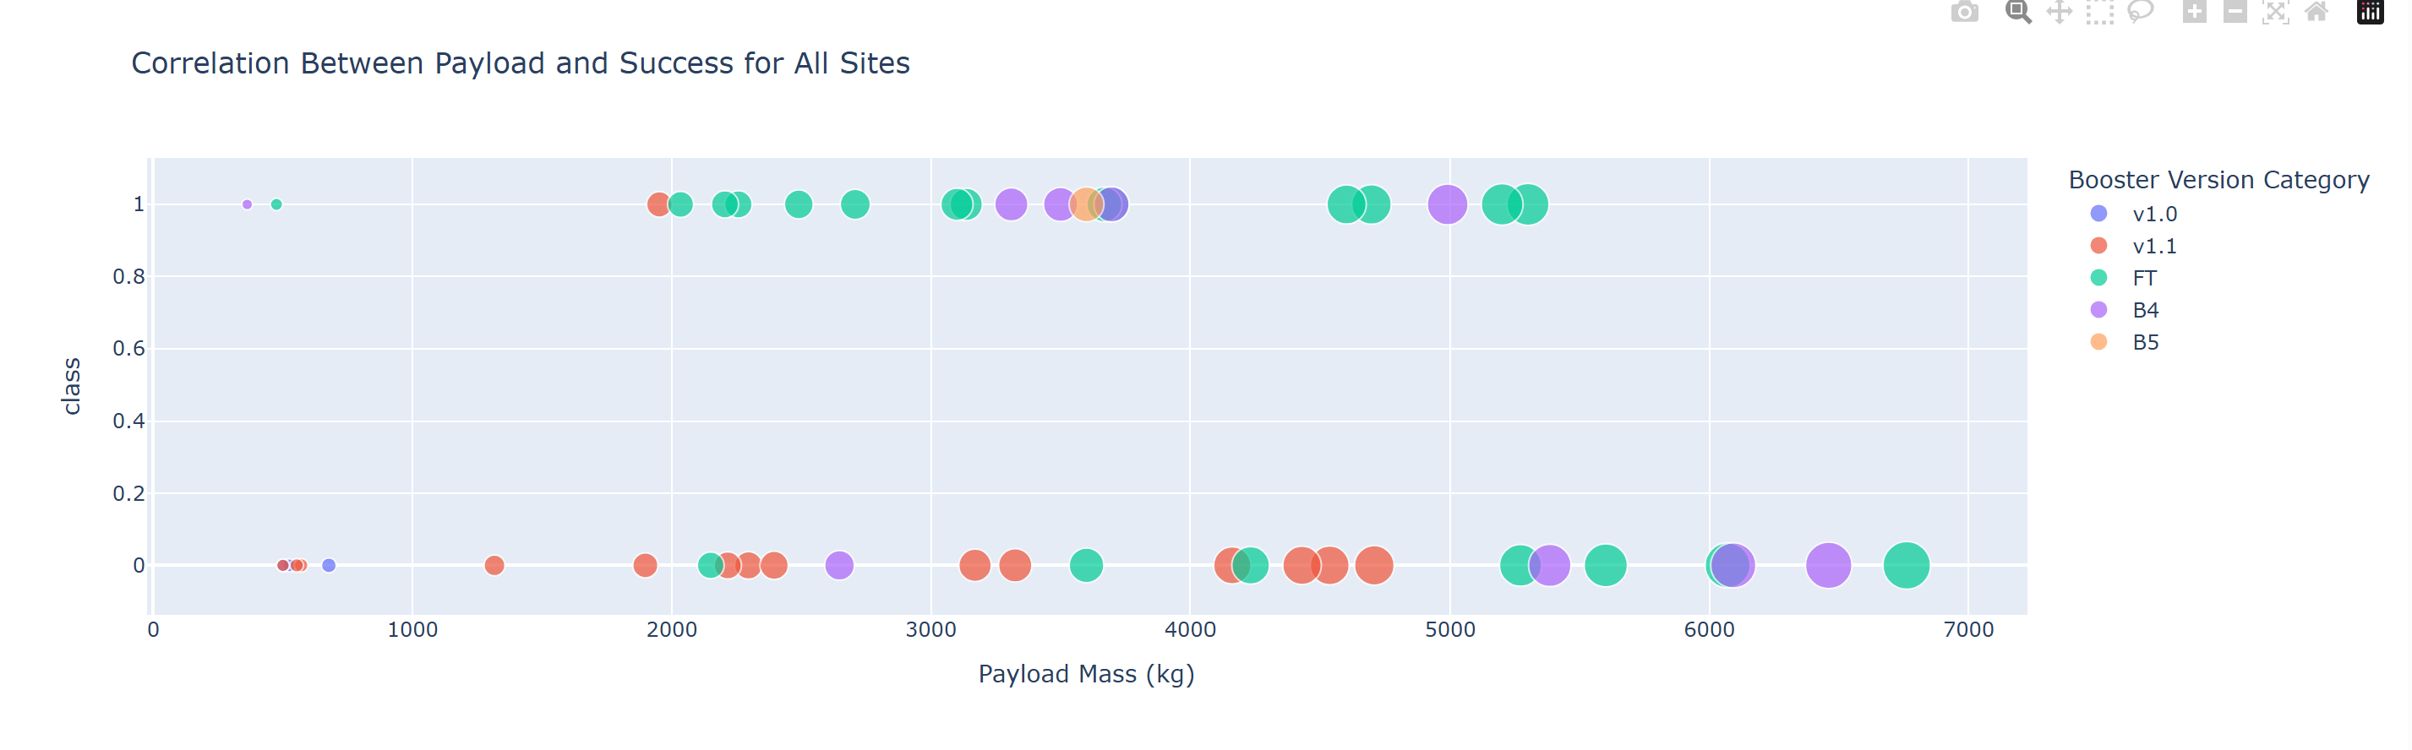
Payload Mass vs. Success Across Booster Versions
“FT” booster is the most frequently used and shows a high success rate across different payload masses.
“v1.0” booster has fewer launches, requiring more data to fully assess performance. Overall, the data suggests no clear link between higher payload masses and lower success rat

Slide 41

Section 5

Slide 42
Classification Accuracy
The Decision Tree achieved the highest accuracy (0.8625), outperforming all other models.
SVM (0.8482) and KNN (0.8482) performed almost identically, slightly better than Logistic Regression (0.8464).
The differences between models are relatively small, but the Decision Tree shows a clear edge in predictive performance.

Slide 43

Confusion Matrix
Since all models performed identically on the test set, their confusion matrices are the same.
The models correctly predicted 12 successful landings when the true label was also successful.
They correctly predicted 3 unsuccessful landings when the true label was unsuccessful.
However, they incorrectly predicted 3 successful landings when the true label was unsuccessful (false positives).

Slide 44
Conclusions
Task: Develop a machine learning model for SpaceY to compete with SpaceX.
Goal: Predict whether Stage 1 will successfully land,
Data Sources: SpaceX API and Wikipedia (via web scraping).
Process:
Labeled and stored data in a DB2 SQL database.
Built a dashboard for visualization.
Trained a machine learning model with an accuracy of 83%.
Application: SpaceY can use this model to estimate Stage 1 landing success before launch, helping decide whether to proceed.
Next Step: Collecting more data could improve accuracy and help identify the best-performing model.

Slide 45


